Slide 1


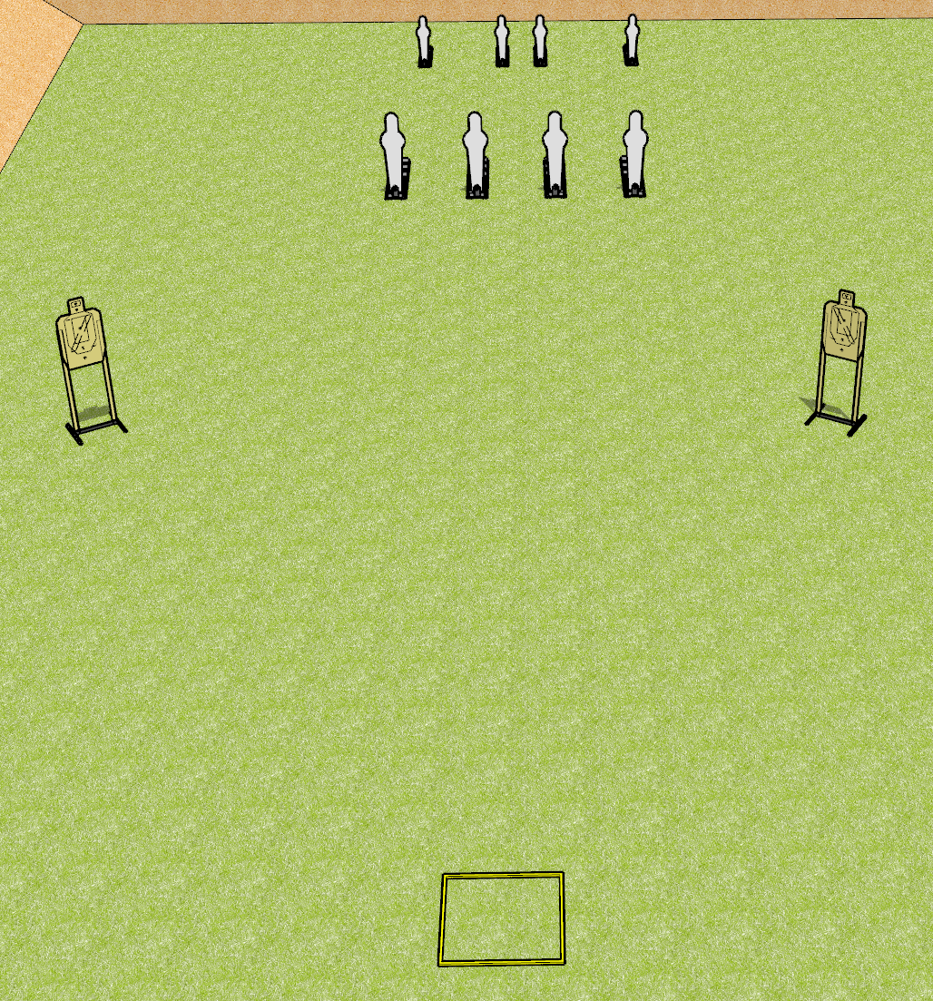
 | Dothan Gun Club – USPSA Match A Stage Has No Name Course Designer : Drew Coleman
START POSITION : Standing in the shooting box, facing uprange. Hands relaxed at sides.
GUN READY CONDITION : Pistol loaded and holstered. PCC buttstock on belt, pointed at back berm. |  | SCORING: Comstock, 16 rounds TARGETS: 2 paper, 8 Steel SCORED HITS: Best 4 on paper, steel until down START-STOP: Audible, last shot RULES: failure to perform a mandatory reload before switching arrays will be a procedural penalty per shot fired.
STAGE PROCEDURE: Engage the steel OR the paper targets from within the shooting box, perform a mandatory reload, and engage the remaining array

